Slide 1
MapReduce scheduling

Slide 2
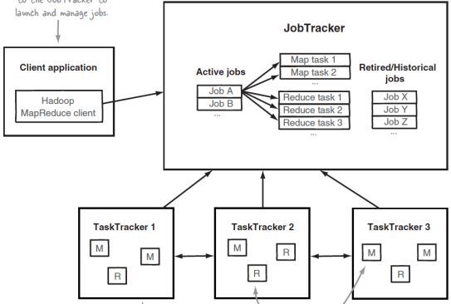
MapReduce Task Scheduling Architecture

Slide 3
MapReduce Task Scheduling Architecture
Again using master-slave model
Master: JobTracker
Slaves: TaskTrackers
Jobs: An entire MapReduce job, e.g. word count
Tasks: Jobs are divided into a set of map tasks and reduce tasks.
The JobTracker
A daemon running on the master node
Takes a job and divides it into map and reduce tasks and issues them to the task trackers (slaves).
Tasks issued to nodes which contain the data
Move computation to data.
The TaskTrackers
Each slave node runs its own TaskTracker daemon
Runs tasks locally and reports to the JobTracker.

Slide 4
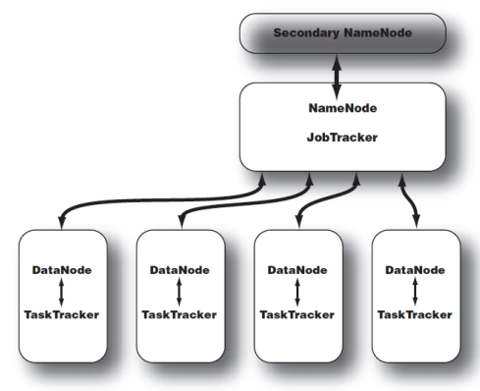
Typical Hadoop Cluster
Master/Slave Architecture
Master node contains both
NameNode (HDFS)
JobTracker (MapReduce Scheduler)
Each slave node contains both
DataNode ( HDFS)
TaskTracker (MapReduce Scheduler)

Slide 5
JobTracker
One JobTracker per Hadoop cluster
JobTracker determines execution plan
Which files to process
Assigns nodes to different tasks
Monitors all running tasks
Single point of failure
Use reliable hardware
TaskTracker sends regular heartbeats to JobTracker
Heatbeat includes progress indicator
JobTracker uses this information to determine the progress of each TaskTracker
If no heartbeat received then slave node is assumed to be dead and its tasks are reassigned to a different TaskTracker
JobTracker is similar to an operating system scheduler
Deciding which node to send each task to
Always tries to send the task to the node containing the data.
Unlike operating system scheduler it allows jobs to run to completion.

Slide 6
TaskTracker
Always a single TaskTracker on each worker node
Each TaskTracker and DataNode run on the same machine
Each TaskTracker is configured with
Number of map and reduce task slots
Indicates how many of each type of task it can run in parallel
Map and reduce slots are configured separately since they consume different amount of resources
Usually, more Map Tasks can be run in parallel compared to Reduce Tasks
Map Tasks must be run on nodes that contain the data whereas Reduce Tasks can be run on any node.
TaskTracker is configured to spill intermediate data that does not fit in RAM into specified directory of local file system.

Slide 7
Failure
Child task failures
Can be caused by
Bad user code
Unexpected data problems
Temporary machine failures
Administrative intervention
Tasktracker reports failure to jobtracker in the next heartbeat
Jobtracker will retry for up to a limited number of times (default is 4)
May run on another machine
A TaskTracker that has many failures will be put on a blacklist and will not be assigned new tasks for 24 hours.
Tasktracker/slave node failure
JobTracker will find out since it will not receive any more heartbeats.
Reassigns work to other TaskTrackers

Slide 8
Failure
JobTracker failures
Very bad!
Single point of failure
Currently running job needs to be restarted.

